Slide 1


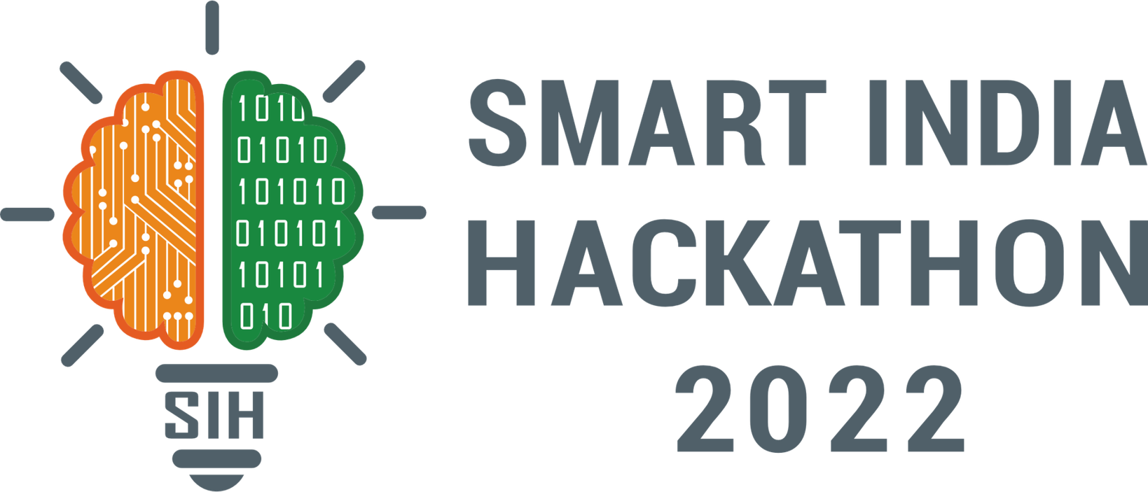
SMART INDIA HACKATHON 2026
• Problem Statement ID – 26192
• Problem Statement Title- Flash Flood Prediction System for Hilly Regions using Multi-Source Data Theme
• Theme- Disaster Management
• PS Category- Software
• Organization- Ministry of Home Affairs / NDRF (DM Division)
• Team ID-
• Team Name - Team GodLike

Slide 2
Team GodLike
DharaDrishti: Cloud-Native AI Flash Flood Intelligence Platform
Problem Statement: In mountainous Himalayan terrains, extreme localized rainfall and cloudbursts cause rapid flash floods with onset times under 30 minutes. Current forecasting software rely on static 2D grid overlays, lack terrain-aware graph routing, and suffer from high false alarm rates, leaving disaster management authorities without actionable lead time.
Solution:
A pure-software, cloud-native AI platform fusing satellite radar, topographic DEM rasters, and numerical weather APIs with Graph Neural Networks (GNN) for hyper-local flash flood prediction.
❖ Multi-Source Data Ingestion Engine: Automated REST APIs continuously stream NASA GPM IMERG, INSAT-3DR, CartoDEM 30m, and IMD WRF weather feeds.
❖ Graph AI Watershed Routing: Converts DEM elevation rasters into directed stream graphs, using GraphSAGE (PyTorch Geometric) to model valley drainage topology.
❖ Spatiotemporal Crest Forecaster: Uses Temporal LSTM / GRU networks to output 6-hour deterministic hydrograph crest curves and 24-hour probabilistic risk maps.
❖ Conformal Uncertainty Quantification: Bayesian SVI (Pyro) calculates calibrated confidence bounds, reducing false alarms by ~18%.
Unique Value Propositions (UVP):
❖ Valley-Centric Graph AI: Accurately computes topological stream connectivity along natural drainage lines rather than artificial grid matrices.
❖ Zero-Infrastructure Footprint: Pure SaaS/cloud deployment eliminates all physical sensor installation and mountain maintenance costs.
❖ Hyper-Local Micro-Catchment Alerts: Discretizes mountain river basins into high-resolution sub-catchments for precision village-level evacuation mapping.
❖ Standardized NDMA CAP Compliance: Native CAP v1.2 XML/JSON engine enables direct plug-and-play interoperability with national disaster command portals.
❖ Instant Geographic Portability: Extensible to all 12 Himalayan states and Western Ghats simply by loading regional DEM rasters and weather APIs.
2
Notes:
2

Slide 3
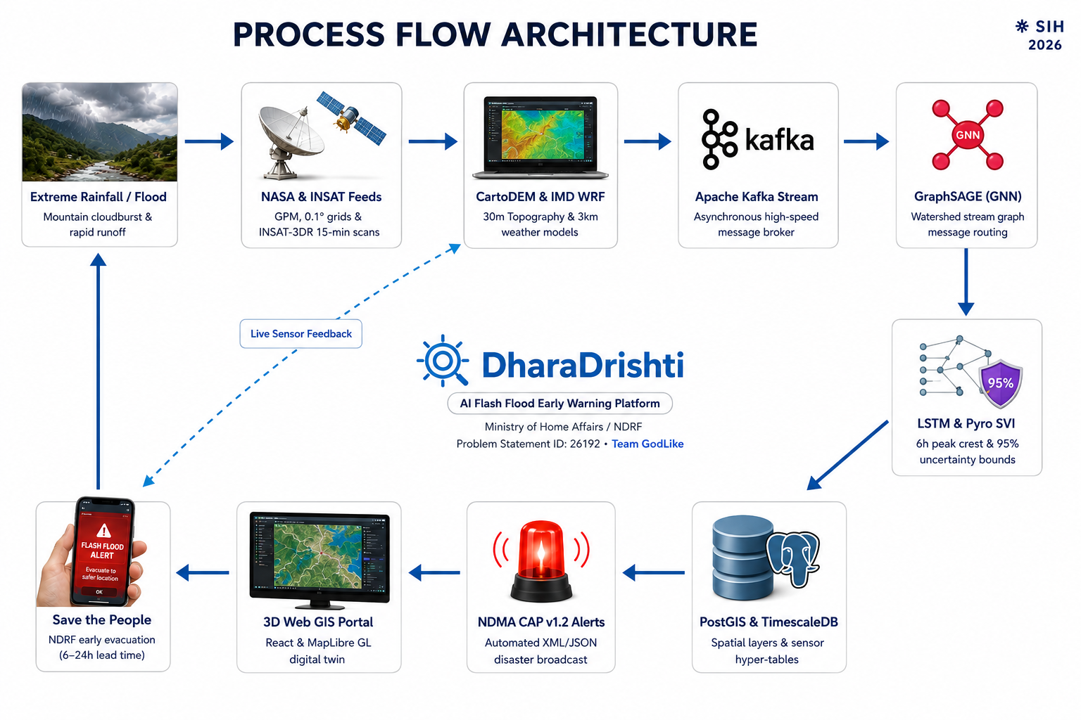



Team GodLike
TECHNICAL SPECIFICATION
Web & Mobile Application Layer:
React.js – TailwindCSS – MapLibre GL 3D – Deck.gl (3D Digital Twin & Inundation Mesh) – Chart.js – Flutter (Android/iOS).
Backend & API Gateway Layer:
Apache Kafka Stream– Celery / Redis Task Queue – GeoPandas – GDAL / Rasterio – Docker – Kubernetes.
AI / ML & Hydrology Engine:
PyTorch Geometric (GraphSAGE GNN) – Temporal LSTM / GRU – Pyro (SVI Uncertainty Quantification) – NetworkX.
Data Storage & Spatial Database:
PostgreSQL + PostGIS (Spatial Vectors & Catchments) – TimescaleDB (Time-Series Hydro Data) – MinIO / S3 (GeoTIFFs).
Alerting & Integration Protocols:
NDMA Common Alerting Protocol (CAP v1.2 XML/JSON) – WebSockets – RESTful APIs – Webhook Dispatchers – JWT Auth.
3
Notes:
3

Slide 4
Team GodLike
FEASIBILITY AND VIABILITY
Technical feasibility:
❖ Multi-Source Data — Integrates satellite, weather, DEM, IoT and historical data.
❖ AI + GIS Integration — GraphSAGE + LSTM with real-time GIS risk visualization.
❖ Scalable Architecture — Cloud/API-ready for expansion to larger regions.
Operational feasibility:
❖ Existing Data Ecosystem — Leverages available satellite, DEM, weather and government data.
❖ Decision Support — Complements existing systems such as IMD flash-flood guidance.
Economic & Development Viability:
❖ Software-Centric — Minimizes dependence on extensive physical infrastructure.
❖ Geographic Portability — Adaptable to new mountain catchments using regional data.
❖ Extensible — Can be expanded to landslides, GLOFs and other mountain hazards.
Potential Technical Challenges and Risks:
Multi-Source Data Latency
Complex Mountainous Terrain
Real-Time Computation
False Alarms & Uncertainty
Strategies to Overcome these Challenges :
❖ Multi-Source Data Fusion — Combines satellite, weather, terrain and sensor observations to improve robustness.
❖ Topographic Bias Correction — Uses elevation, slope and flow information to account for terrain-related estimation bias.
❖ Optimized Model Inference — Uses localized graph processing and model optimization for faster real-time inference.
❖ Uncertainty-Aware Alerting — Uses SVI-based uncertainty estimates, persistence checks and multiple indicators to reduce unreliable alerts.
4
Notes:
4

Slide 5
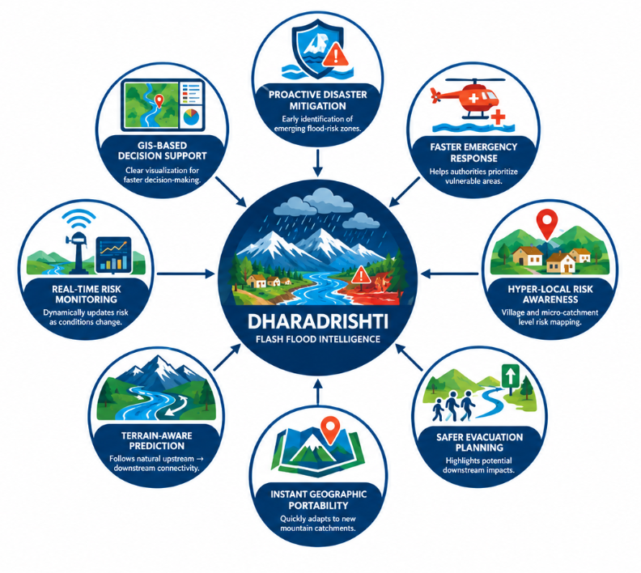
Team GodLike
IMPACT AND BENEFITS
Potential Impact :
❖ Proactive Disaster Mitigation — Early identification of emerging flood-risk zones.
❖ Faster Emergency Response — Helps authorities prioritize vulnerable areas.
❖ Hyper-Local Risk Awareness — Village and micro-catchment level risk mapping.
❖ Safer Evacuation Planning — Highlights potential downstream impacts.
❖ Unified Situational Awareness — One platform for multi-source disaster information.
❖ Community Resilience — Improves preparedness for mountain hazards.
Benefits :
❖ Instant Geographic Portability — Quickly adapts to new mountain catchments using regional DEM and weather data.
❖ Terrain-Aware Prediction — Follows natural upstream → downstream connectivity.
❖ Real-Time Risk Monitoring — Dynamically updates risk as conditions change.
❖ Uncertainty-Aware Alerts — Shows prediction confidence alongside risk.
❖ GIS-Based Decision Support — Clear visualization for faster decision-making.
❖ Cross-Platform Accessibility — Supports web, mobile and API-based access.
❖ Open & Interoperable — Designed for integration with existing disaster-management systems.
5
Notes:
5

Slide 6
Team GodLike
RESEARCH AND REFERENCES
Research References:
[1] Sharma, P., & Sharma, S. (2026). Flood Risk Follows Valleys, Not Grids: Graph Neural Networks for Flash Flood Susceptibility Mapping with Conformal Uncertainty. arXiv:2603.15681
[2] Liu, W., & Li, D. (2026). ASTUNN: Spatiotemporal uncertainty guided neural network for flood management in mountainous areas. Alex. Eng. J., 136, 140–156.
[3] Dhote, P. R., et al. (2018). Experimental flood early warning in parts of Beas basin using weather & hydrological models. ISPRS Arch., XLII-5, 221–225.
[4] Buytaert, W., & Hannah, D. M. (2023). Developing a SMART flood early warning system: Lesser Himalayas.
[5] HiFlo-DAT: Historical flood-event database covering 128 flood events at 59 locations in Himachal Pradesh (1846–2020), used as a regional historical reference for our system.
Project References:
1. Docs: System Software Architecture | GNN Model Specs | API Docs
2. GitHub Repo: Frontend React 3D GIS | FastAPI Backend | GNN Pipeline
3. Standards: NDMA CAP v1.2 Protocol | WMO SAsiaFFGS | OGC Web Standards
Software Architecture & Cloud Deployment Specs:
❖ Cloud Infrastructure: Dockerized microservices orchestrated on Kubernetes / MeghRaj Cloud.
❖ Database Stack: PostgreSQL + PostGIS (Spatial Vector) & TimescaleDB (Time-series hydrographs).
❖ AI / ML Inference: PyTorch Geometric GraphSAGE (GNN) + Temporal LSTM + Pyro SVI UQ.
❖ APIs & Security: FastAPI async gateway with OAuth2/JWT authentication and NDMA CAP v1.2 feeds.
6
Notes:
6

